Slide 1
Storage, Databases & Analytics
Sid Pasumarthy
04/22/2021

Slide 2
Storage

Slide 3
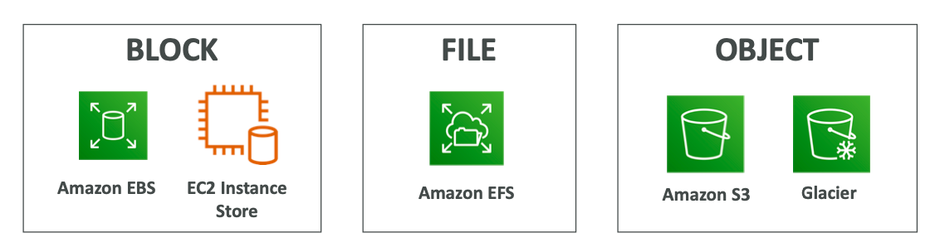
Types of Storage
Storage Area Network
Uses Optical Fiber
Low Latency
Highly Redundant
One server one EBS volume
Network Attached Storage
Highly Scalable
Multiple Users
Simultaneous Read/Writes
Store using REST APIs
Highly Scalable
Ideal for Unstructured Data
Globally unique identifier
Durability
Notes:
Storage Area Network: Servers connect to block storage hard drives using a SAN
Network Attached Storage: All servers and the storage are on a LAN
Block Storage
Traditionally when you think of a block storage, think of a hard drive with partitions. Each partition can store files on a filesystem like NTFS (windows), EXT4 (linux) etc. as 512 byte blocks. Advantage of blocks is that if you make changes in a file, only the blocks that are affected need to be changed.
Storage Area Network: In cloud computing SAN consists of a network of block storage devices. It is similar to NAS but SAN is more efficient because it is connected over optic fibres rather than a LAN.
Network Attached Storage (File based storage)
NAS devices are connected to a local area network. It is a collection of hard drives in a device which can have RAID configurations (for efficiency or replication). It is great for collaboration and centralized control of file network. It's a shared drive where if there is lot of traffic on the network, the performance of the shared drive can slow down. You don't need to size it.
Think Amazon EFS
Object Storage
Unlike a file, an object is a bunch of unstructured data which consists of an ID, Metadata and Blob. Every time you update an object you have to update the entire thing (object). This type of storage is good for write one, read many times type of data. With object storage data is requested using HTTP requests.
Think Amazon S3

Slide 4
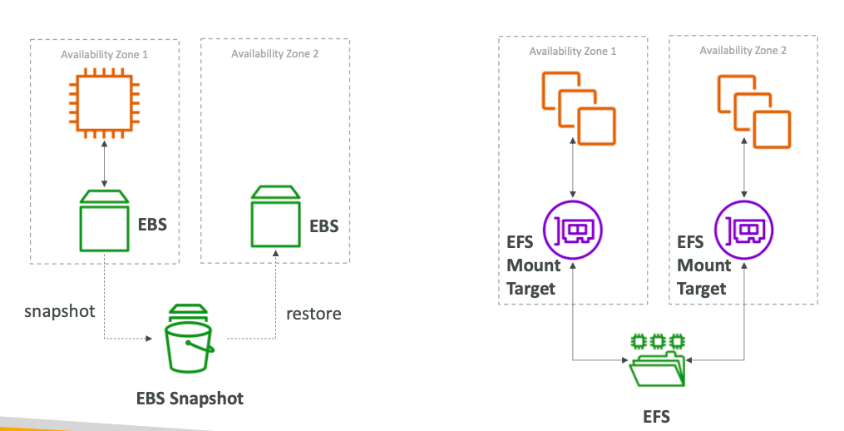
AWS EC2 Instance Storage
EBS
EFS
Instance Volume
Notes:
EFS is:
Network filesystem (that means it may have bigger latency but it can be shared across several instances; even between regions)
It is expensive compared to EBS (~10x more) but it gives extra features.
It's a highly available service.
It's a managed service (don't need to size it)
Can be accessed by multiple EC2 instances simultaneously
EBS is:
A block storage (so you need to format it). This means you are able to choose which type of file system you want.
It is really fast
It is relatively cheap
You can snapshot an EBS (while it's still running) for backup reasons
But it only exists in a particular region. Although you can migrate it to another region, you cannot just access it across regions
You can now increase volume size, adjust performance, or change the volume type while the volume is in use. You can continue to use your application while the change takes effect.

Slide 5
Amazon S3 Introduction
An Object Store (Not a FileSystem)
One of the main building blocks of AWS
Many websites use S3 as a backbone
S3 allows people to store objects (files) in “Buckets”
Buckets must have globally unique name
Objects have a key
s3://my-bucket/my_file.txt
s3://my-bucket/my_folder1/another_folder/my_file.txt
Max object size is 5TB. Use multi-part upload for more than 5GB
Objects in S3 can be encrypted
Notes:
User based IAM policies
Resource based bucket policies
S3 is:
An object store (not a file system).
You can store files and "folders" but can't have locks, permissions etc like you would with a traditional file system
This means, by default you can't just mount S3 and use it as your webserver
But it's perfect for storing your images and videos for your website
Great for short term archiving (e.g. a few weeks). It's good for long term archiving too, but Glacier is more cost efficient.
Great for storing logs
You can access the data from every region (extra costs may apply)
Highly Available, Redundant. Basically data loss is not possible (99.999999999% durability, 99.9 uptime SLA)
Much cheaper than EBS.
You can serve the content directly to the internet, you can even have a full (static) website working direct from S3, without an EC2 instance

Slide 6
Amazon S3 Use Cases
Data lakes & big data analytics
Backup and Disaster Recovery
Archive
Hybrid Cloud storage (AWS Storage Gateway)
Application hosting
Media hosting
Software Delivery
Static website

Slide 7
S3 Storage Classes
Amazon S3 Standard - General Purpose
Amazon S3 Standard-Infrequent Access (IA)
Amazon S3 One Zone-Infrequent Access
Amazon S3 Intelligent Tiering
Amazon Glacier
Amazon Glacier Deep Archive
Can create lifecycle policies to transition objects between storage classes
Notes:
Learn about the differences
Mention Snow Family of Devices
Standard – can sustain 2 concurrent facility failures, can retrieve data quickly
Standard IA – there are retrieval fees, same as standard
One Zone IA – Same as IA but stored in single AZ, good for secondary backup, or data which you can recreate
Amazon Glacier – cheap:
• Expedited (1 to 5 minutes)
• Standard (3 to 5 hours)
• Bulk (5 to 12 hours)
Amazon Glacier Deep Archive – cheapest:
Standard (12 hours)
Bulk (48 hours)

Slide 8
Databases

Slide 9
Databases Introduction
Storing data on disk (EFS, EBS, S3) can have its limits
Sometimes, you want to store data in a database
You can structure the data
You can build indexes to efficiently query/search
You can define relationships between datasets
Databases are optimized for a purpose

Slide 10
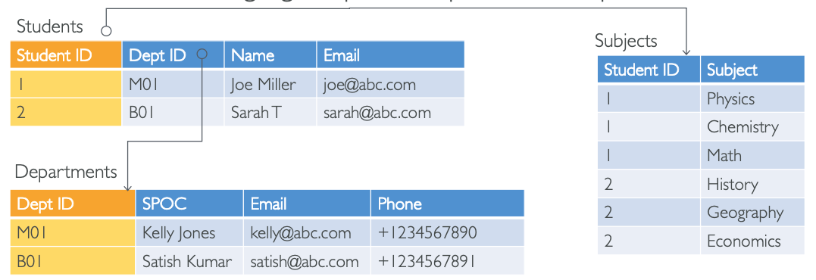
Relational Databases
Looks just like Excel spreadsheets, with links between them!
Can use the SQL language to perform queries/lookups
Notes:
Important Aspects of Relational Databases
SQL is the primary interface
Vertical Scaling is possible but horizontal is difficult or not possible
Maintains data integrity – overall completeness, accuracy and consistency of data
Great for transactional data. Transactions provide an “all-or-nothing” proposition, meaning that entire transaction must complete as a single unit and be written to the database. A transaction results in a commit or a rollback
ACID Compliance for integrity – Atomicity, Conistent, Isloated, Durable
Atomicity requires that either transaction as a whole be successfully executed or if a part of the transaction fails, then the entire transaction be invalidated. Consistency mandates the data written to the database as part of the transaction must adhere to all defined rules, and restrictions including constraints, cascades, and triggers. Isolation is critical to achieving concurrency control and makes sure each transaction is independent unto itself. A database aquired locks on data to maintain a high level of isolation. Durability requires that all of the changes made to the database be permanent once a transaction is successfully completed

Slide 11
NoSQL Databases
NoSQL = non-SQL – non relational databases
Purpose built and have flexible schemas for building modern applications
Benefits:
Flexibility: easy to evolve data model
Scalability: designed to scale-out by using distributed clusters
High-performance: optimized for a specific data model
Able to process both unstructured and semi-structured data
There are no complex relationships
Deduplication of data can occur
Examples: Key-value, document, graph, in-memory, search
Notes:
There are collections and each collection is built in such a way that a query can get all the data it needs from one collection
More the collections, more places data needs to be written
It’s a distributed database so both horizontal and vertical scaling is possible

Slide 12
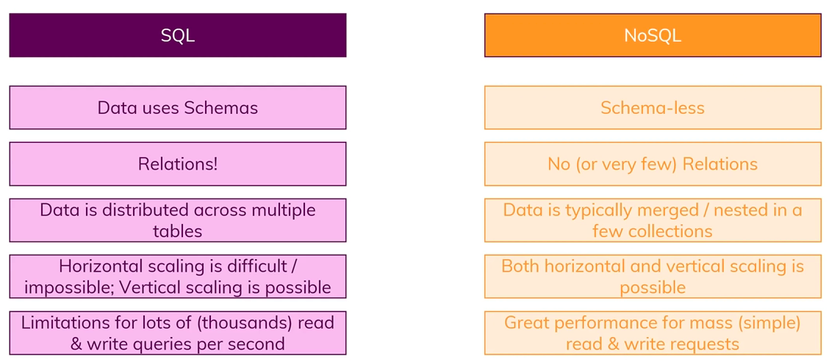
NoSQL Databases

Slide 13
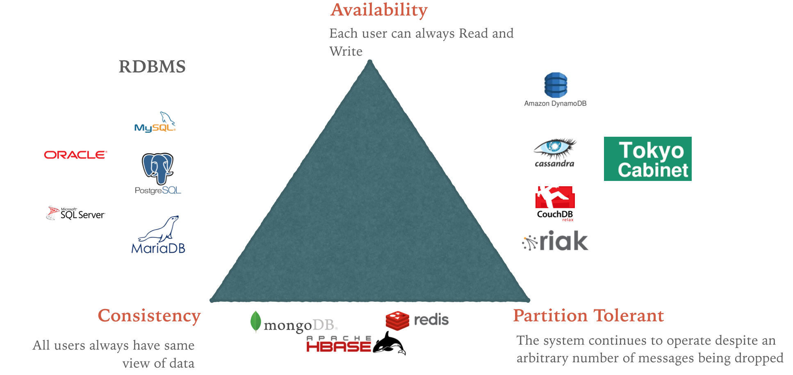
CAP Theorem

Slide 14
AWS RDS Overview
RDS stands for Relational Database Service
It allows you to create databases in the cloud that are managed by AWS
Postgres
MySQL
MariaDB
Oracle
Microsoft SQL Server
Aurora (AWS Proprietary database which supports PostgreSQL and MySQL)
Notes:
• Automated provisioning, OS patching
• Continuous backups and restore to specific timestamp (Point in Time Restore)!
• Monitoring dashboards • Read replicas for improved read performance • Multi AZ setup for DR (Disaster Recovery)
• Maintenance windows for upgrades • Scaling capability (vertical and horizontal) • Storage backed by EBS (gp2 or io1)
RDS can have up to 15 read replicas and can be multi AZ

Slide 15
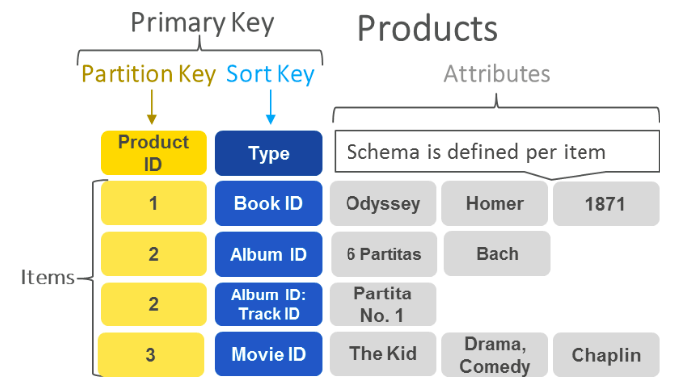
AWS DynamoDB Overview
It is a fully managed key/value NoSQL database
Scales to massive workloads, distributed database
Millions of requests per second, trillions of rows
Has autoscaling capabilities

Slide 16
RedShift Overview
Based on PostgresSQL but not used for OLTP
It’s OLAP – Online Analytical Processing
Used as a data warehouse
Columnar storage of data
Massively Parallel Query Execution
Load data once every hour, not every second
Highly Available
Notes:
Data warehouse is a type of data management system that is designed to enable and support BI activities, especially analytics

Slide 17
Homework
In Memory Databases (Elasticache, DAX)
DocumentDB, Neptune, QLDB, Managed Blockchain

Slide 18
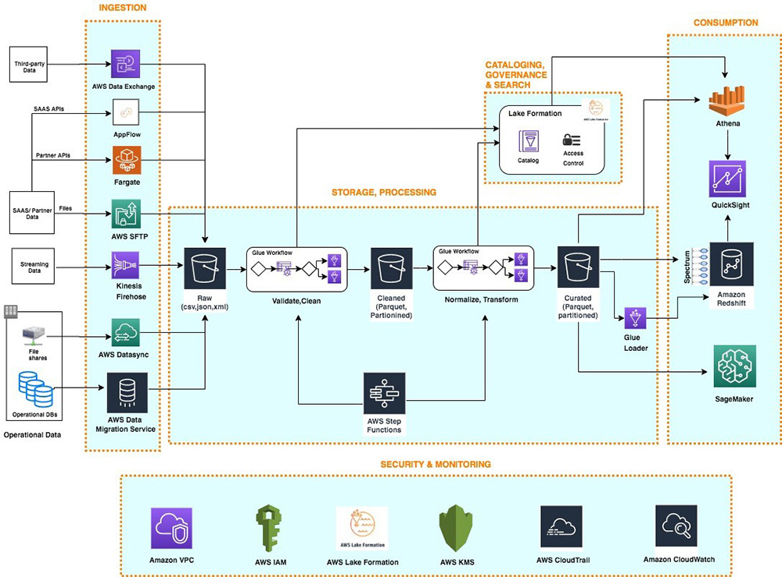

Analytics
Notes:
Data warehouse is a type of data management system that is designed to enable and support BI activities, especially analytics

Slide 19
Questions

